Slide 1
Common Core State Standards Initiative
A Fundamental Shift Toward College and Career Readiness in K-12 Education

Slide 2
What the New Standards Mean for Students
The standards are designed to help all young people get prepared for college and careers.
The standards include changes, or "shifts," in how teachers teach to help children succeed in the topics and skills that matter most.
The Common Core standards ask teachers and students to dig deeper into the core skills and concepts for each grade level. This means that students will learn much more about fewer topics.

Slide 3
How the Standards Were Developed
Forty-six states brought together experts, teachers and researchers to write the Common Core State Standards.
Almost 10,000 comments and suggestions were taken in account when forming the standards.
15% of the standards are reserved for each state to formulate on their own.

Slide 4
The Design of Common Core
Three minute overview of Common Core
http://www.youtube.com/watch?v=5s0rRk9sER0

Slide 5
Testing
STAR testing no longer will be conducted as it has been.
Current discussion in the legislature regarding pilot program or state wide.
2015 All schools will be taking new CCCS tests online
Spring 2014 – Computerized testing
Smarter Balanced Consortium – Beginning in grade 3

Slide 6
Testing
Concerns
Students ability to adapt to new online testing
Keyboarding skills
Explain thinking and reasoning through writing
Timing out on tests
Students competence on computers
English Second Language Disadvantage
Technology Issues
Server’s ability to handle amount of traffic
Trouble shooting technical problems
Lack of computers to test students

Slide 7
Testing and Scoring
How are students measured?
Computer adaptive testing adjusts to a student’s ability by basing the difficulty of future questions on previous answers, providing more accurate measurement of student achievement, particularly for high and low-performing students.
Concerns over essay grading
Harvard and MIT have offered EdX (AEG – automated essay grader)
Unclear how the Consortia will grade - with AEG, human graders, or a combination.
Notes:
Fooling the the AEG system takes a good writer – sentence structure, length, sentence variation, transitions, word choice (syllables). A poor writer is identified.

Slide 8
Computerized Testing
Testing will be all computerized.
Expected loss of testing scores
Testing will initially be more difficult
Students will be answering in different ways
Selected Response
Constructed Response
Extended Response
Technology Enhanced
Performance Task
Fremont is beginning to initiate computer responses for their Treasures testing – bubble in and constructed response.

Slide 9
Pedagogical Shifts in ELA
Shift 1- Balancing Informational & Literary Text
Students read a true balance of informational and literary text.
Shift 2 – Knowledge in the Disciplines
Students build knowledge about the world (domains/ content areas) through TEXT rather than the teacher or activities.
Shift 3 – Staircase of Complexity
Students read the central, grade appropriate text around which instruction is centered. Teachers are patient, create more time and space and support in the curriculum for close reading.

Slide 10
Pedagogical Shifts in ELA
Shift 4- Text-based Answers
Students engage in rich and rigorous evidence based conversations about text.
Shift 5 – Writing from Sources
Writing emphasizes use of evidence from sources to inform or make an argument.
Shift 3 – Academic Vocabulary
Students constantly build the transferable vocabulary they need to access grade level complex texts. This can be done effectively by spiraling like content in increasingly complex texts.

Slide 11
Shifts for Students in ELA
Read as much non fiction as fiction.
Learn about the world by reading.
Read more challenging material closely.
Discuss reading using evidence.
Write non-fiction using evidence.
Increase academic vocabulary.

Slide 12
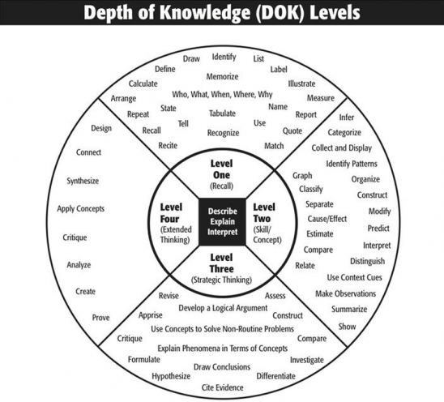
Depth of Knowledge
http://vimeo.com/42788913

Slide 13
Pedagogical Shifts in Math
Shift 1- Focus
Teachers significantly narrow and deepen the scope of how time and energy is spent in the math classroom. They do so in order to focus deeply on only the concepts that are prioritized in the standards.
Shift 2 – Coherence
Principals and teachers carefully connect the learning within and across grades so that students can build new understanding onto foundations built in previous years.
Shift 3 – Fluency
Students are expected to have speed and accuracy with simple calculations; teachers structure class time and/or homework time for students to memorize, through repetition, core functions.

Slide 14
Pedagogical Shifts in Math
Shift 4- Deep Understanding
Teachers significantly narrow and deepen the scope of how time and energy is spent in the math classroom. They do so in order to focus deeply on only the concepts that are prioritized in the standards.
Shift 5 – Coherence
Principals and teachers carefully connect the learning within and across grades so that students can build new understanding onto foundations built in previous years.
Shift 6 – Fluency
Students are expected to have speed and accuracy with simple calculations; teachers structure class time and/or homework time for students to memorize, through repetition, core functions.

Slide 15
Shifts for Students in Math
Focus: learn more about fewer, key topics
Build skills within and across grades.
Develop speed and accuracy. Really do it.
Use math it in the real world.
Think fast AND solve problems.
What math looks like in a classroom
https://www.teachingchannel.org/videos/multiplication-division-in-the-core

Slide 16
Rigor in Math
http://vimeo.com/64177962

Slide 17
District’s Current Timeline for CCCS
Summer-Winter 2013 (Sept – Dec 2013)
Development and implementation of performance task assessments aligned to CCSS • Continue implementation of Technology Plan • Parent Community Meetings by Attendance Areas focused on “The Transition to the New Assessments”
Winter-Spring 2013-2014 (Dec 2013 – June 2014)
Utilizing the feedback from the two years of strategic work and activities, begin making necessary adjustments to instruction and curriculum, site-based assessments and instructional goals

Slide 18
Oliveira’s Current Timeline of CCCS
December 2013
Grade levels identified what standards they have met to date and mapped out plans to meet the rest by year’s end.
Performance Tasks: (Connected to real world problems)
Writing across the disciplines
Math (Problems of the Month)
ELA (alignment with CC – literature studies)

