Slide 1
SPPA/LCAP Presentation
Developing Goals
for the 17-18 School year

Slide 2
CAASP ELA Data
Here is where we are: Irvington 2015 ELA CAASP Data: Standard Exceeded- 47% Standard Met- 29% Standard Nearly Met- 15% Standard Not Met- 9%
Irvington 2016 ELA CAASP Data: Standard Exceeded- 54% Standard Met- 25% Standard Nearly Met- 13% Standard Not Met- 7%

Slide 3
CAASP Math Data
Irvington 2015 CAASP Math Data (All 11th gr. students):
Standard Exceeded- 49% Standard Met- 19% Standard Nearly Met- 19% Standard Not Met- 13%
Irvington 2016 CAASP Math Data (All 11th gr. students):
Standard Exceeded- 49% Standard Met- 21% Standard Nearly Met- 11% Standard Not Met- 19%

Slide 4
What is EAP?

Slide 5
Irvington EAP Results
Irvington 2015 CAASP ELA Data: Standard Exceeded- 47% - Ready Standard Met- 29% - Conditionally Ready Standard Nearly Met- 15% - Not Yet Ready
Standard Not Met- 9% - Not Ready
Irvington 2015 CAASP Math Data Standard Exceeded- 49% - Ready Standard Met- 19% - Conditionally Ready Standard Nearly Met- 19% - Not Yet Ready Standard Not Met- 13% - Not Ready

Slide 6
How Do Students Get Ready?
ELA ACT Score: 19-21
Math ACT Score: 20-22
ELA SAT: 460-490
Math SAT: 490-540
English Reading and Writing Curriculum (ERWC)
AP English
Math class w/Alg II/Trig as Pre-Req.

Slide 7
SPPA PLAN DEVELOPMENT

Slide 8
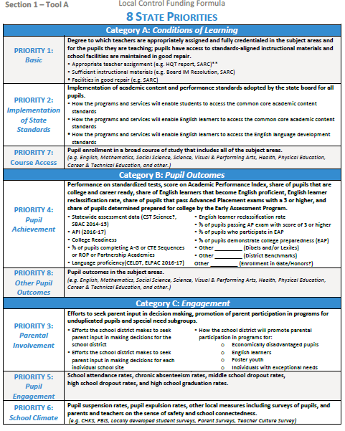

Slide 9
15-16 SPPA/LCAP Goals
Goal 1
Category A/Priority 7: Conditions of Learning
By 2016 (due to timing of SPPA plan development), increase the number of students eligible for the CSU/UC system by 3%
Description:
The percentage of graduating seniors who completed the CSU A-G requirements and were eligible for CSU admission for the graduating class of 2014 was 75%. In evaluating the
data, we determined that there were factors we can control that contributed to this percentage. We identified a significant group of 11th grade students who drop out of the second semester of a required course (Physical Science, Algebra 2, or the 2nd year of a world language class. Additionally, we identified students who did not enroll in all of the required A-G Courses in grades 9-12.

Slide 10
15-16 SPPA/LCAP Goals
Goals 2 and 3
Category B/Priority 4: Pupil Achievement
By 2017, increase the number of students “Ready for College” on the Early Assessment Program assessment by 3% in ELA
By 2017, increase the number of students “Ready for College” on the Early Assessment Program assessment by 3% in Math

Slide 11
15-16 SPPA/LCAP Goals
Goal 4
Category C/Priority 3: Parental Involvement
By June 2016, increase the number of parents of students from identified subgroups involved in stakeholder groups such as School Site Council, PRAA, PIQE, PTSA, SportsBoosters, Band Boosters, etc.)

Slide 12
16-17 SPPA Timeline
May 2, 2016- Draft #1
June 1, 2016Revisions Due to Secondary Education
June 22, 2016- Board Adoption

Slide 13
Irvington SPPA Development Timeline
February | March | April | May
Site Council gives input into SPPA goals. | Update School Profile, Action Plans , and Budget. | Site Council Approves Draft #1 of SPPA Plan | Submit any required revisions to Secondary Education by date.
Curriculum Council gives input into SPPA goals. | Curriculum Council reviews Draft# 1 of SPPA Plan | Submit to Secondary Education
English and Math Departments develop goals for Category B: Pupil Achievement

