Slide 1
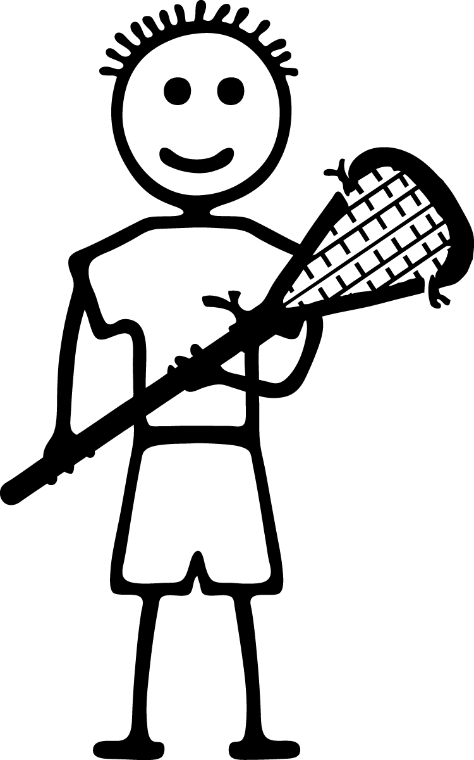
Lacrosse Skills Overview
The game of lacrosse requires certain skills that will help a player handle a lacrosse ball effectively, ultimately providing the opportunity for a shot or goal. These basic ball skills include scooping, passing, catching, cradling and shooting. Lacrosse is also a very physical sport and requires an understanding of dodging techniques. Practicing and mastering these basic skills will make for a more rewarding playing experience.

Slide 2
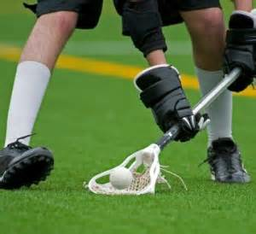
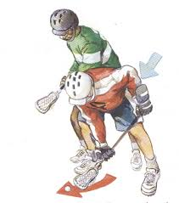
SCOOPING
Scooping is the act of picking a ball up off the ground and is the most commonly used ball recovery technique.
While running toward the ball, the player's knees are bent. The head of the stick is dropped to the ground and the stick handle is positioned a few inches higher. A quick forward motion with the head of the stick toward the ball will scoop it into the pocket of the head.

Slide 3
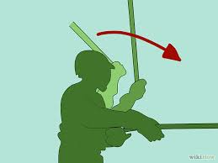
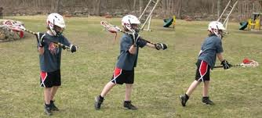
PASSING
One hand will be at the end of the stick while the other is placed in the middle of the stick.
While facing the stick head in the direction the ball will be passed, the player quickly snaps the stick to fling the ball from the pocket in the head to another player.
To move the ball down field, a player with possession of the ball will place the stick at his side with the stick head next to his face.

Slide 4
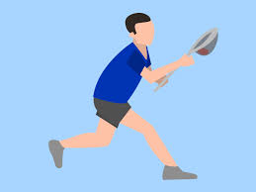
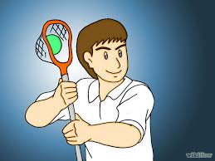
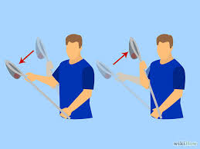
Catching
Catching a passed ball requires concentration. The stick is positioned to the side of the body with the head of the stick up next to the face
One hand is at the base of the stick, while the other is near the throat of the stick. As the ball comes to the player, the stick head is positioned in the ball's path and the ball is received in the pocket.
The player will move the head backwards to absorb the impact of the ball and allow it to settle in the pocket.

Slide 5
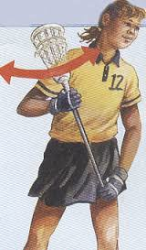
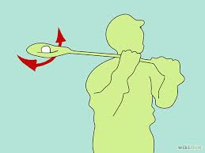
CRADLING
Cradling is used by a player to maintain possession of the ball. While the ball is in the pocket of the stick head, the wrists of the player are twisted back and forth to keep the ball in the pocket.
This technique should be practiced while standing or running to gain proficiency in maintaining possession of the ball at all times

Slide 6
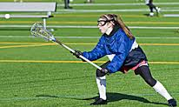
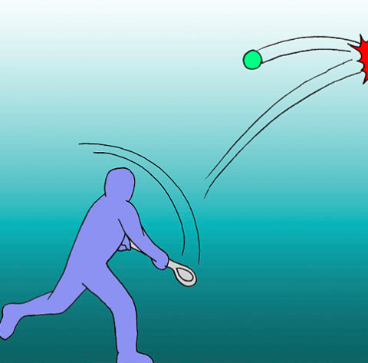
SHOOTING
Shooting is the actual act of trying to score a goal. When shooting, the player will take a low, wide and stable stance.
The shoulder and hips of the lower hand on the stick are aimed at the goal with the torso rotated away. The torso and upper hand on the stick are then brought forward, forcefully, to propel the ball at the goal.

Slide 7
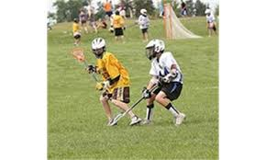
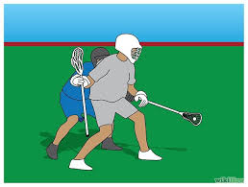
DODGING
Developing the skill of dodging allows a player to avoid members of the opposing team. This helps to gain more protection when in possession of the ball. There are different types of dodges, each with a specific purpose, whether to fake out an opponent, or spin to avoid a defensive player.

Slide 8
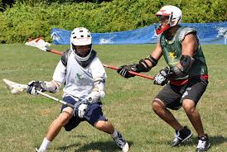
MORE TERMS
Marking: When a player shadows an opposing team member within the length of a stick.
Pick: An offensive maneuver in which a stationary player attempts to block the path of a defender guarding another offensive player.
Fast-Break: A transition scoring opportunity in which the offense has at least a one-man advantage.

Slide 9
THE CREASE A circle around the goal with a radius of nine feet into which only defensive players may enter.

Slide 10
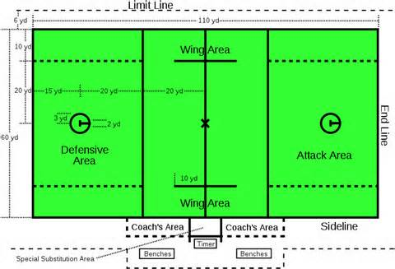
THE LACROSSE FIELD

Slide 11
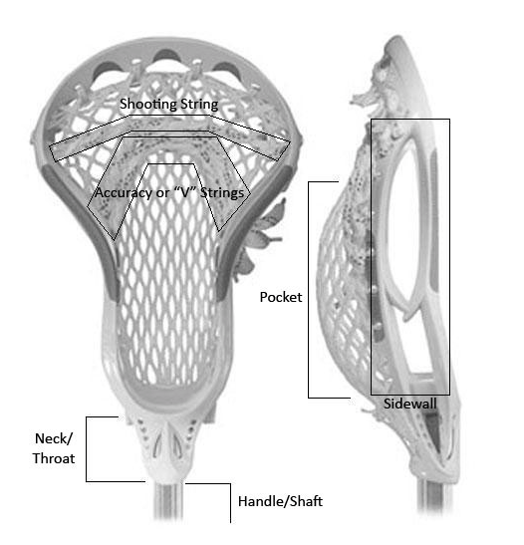
The lacrosse stick or “crosse”

Slide 12
History Lacrosse is the national game of Canada. It was invented by the Native Americans.
Stick Terms
Crosse or Basket: top webbed part of the lacrosse stick
Shaft: handle of the lacrosse stick use shoulder width grip
Butt: bottom of the lacrosse stick
Box: area next to ear and above shoulder where carrying, catching and throwing take place
Soft hands: act of giving on impact when catching the ball
Finishing High: short abrupt follow through used when throwing

Slide 13
PE Lacrosse Rules
No stick-to-stick contact.
No body-to-body or body-to-stick contact.
Two hands on the stick at all times.
Maintain control of your body at all times.
No covering the ball with your stick.
Respect your teammate and opponents at all times.
Three passes before shooting (one has to be to a female).
Teams RO SHAM BO to win first pass, to begin the game.
No one is allowed inside the crease while the ball is in play (other than the Goalie).
Crosses (the stick) are not allowed in the crease.
A player may only possess the ball for 5 seconds.
If a ball is stopped in the crease a defensive player may enter and obtain possession. Dead ball (inside the crease) restarts are taken from the top of the crease.
The first pass is taken from the center line.
After a goal is scored, the scored upon team restarts play from the center line.

Slide 14
POSITIONS
Attack: Responsibility is to score goals. The attack-men will limit their play to the offensive end of the field and may not cross the midfield line. There will be 2-3 attack-men.
Midfield: Responsibility is to cover the entire field, playing both offense and defense. There will be2-3 midfielders.
Defense: Responsibility is to defend the goal. These players are only allowed on the defensive end of the field. There will be 2-3defensive players.
Goalie: Stop the offensive team from scoring.

Slide 15
OFFENSE AND DEFENSE
Offense:
The ball may be advanced by running, passing, or rolling it on the ground. Scooping may only be one on one. Scoring occurs when the ball crosses the plane of the goal. A goal attempt must be made from outside the crease area. Any goal made from inside the crease area will not be counted. There must be 3 complete passes before a team can attempt to score (one must be to a female). A bounce pass can count as a pass.
Defense:
One on one defense must be played. No double teaming is allowed. The stick of one player may not touch another player’s stick. Defense will be played like that of basketball. Players may not purposely contact another player.
Out of Bounds:
If the ball goes out of play, the team who touched it last loses possession. The team gaining possessions will pass it in from where it went out of bounds. No defensive player may be within 5 steps of the player putting the ball back in play.

